Slide 1


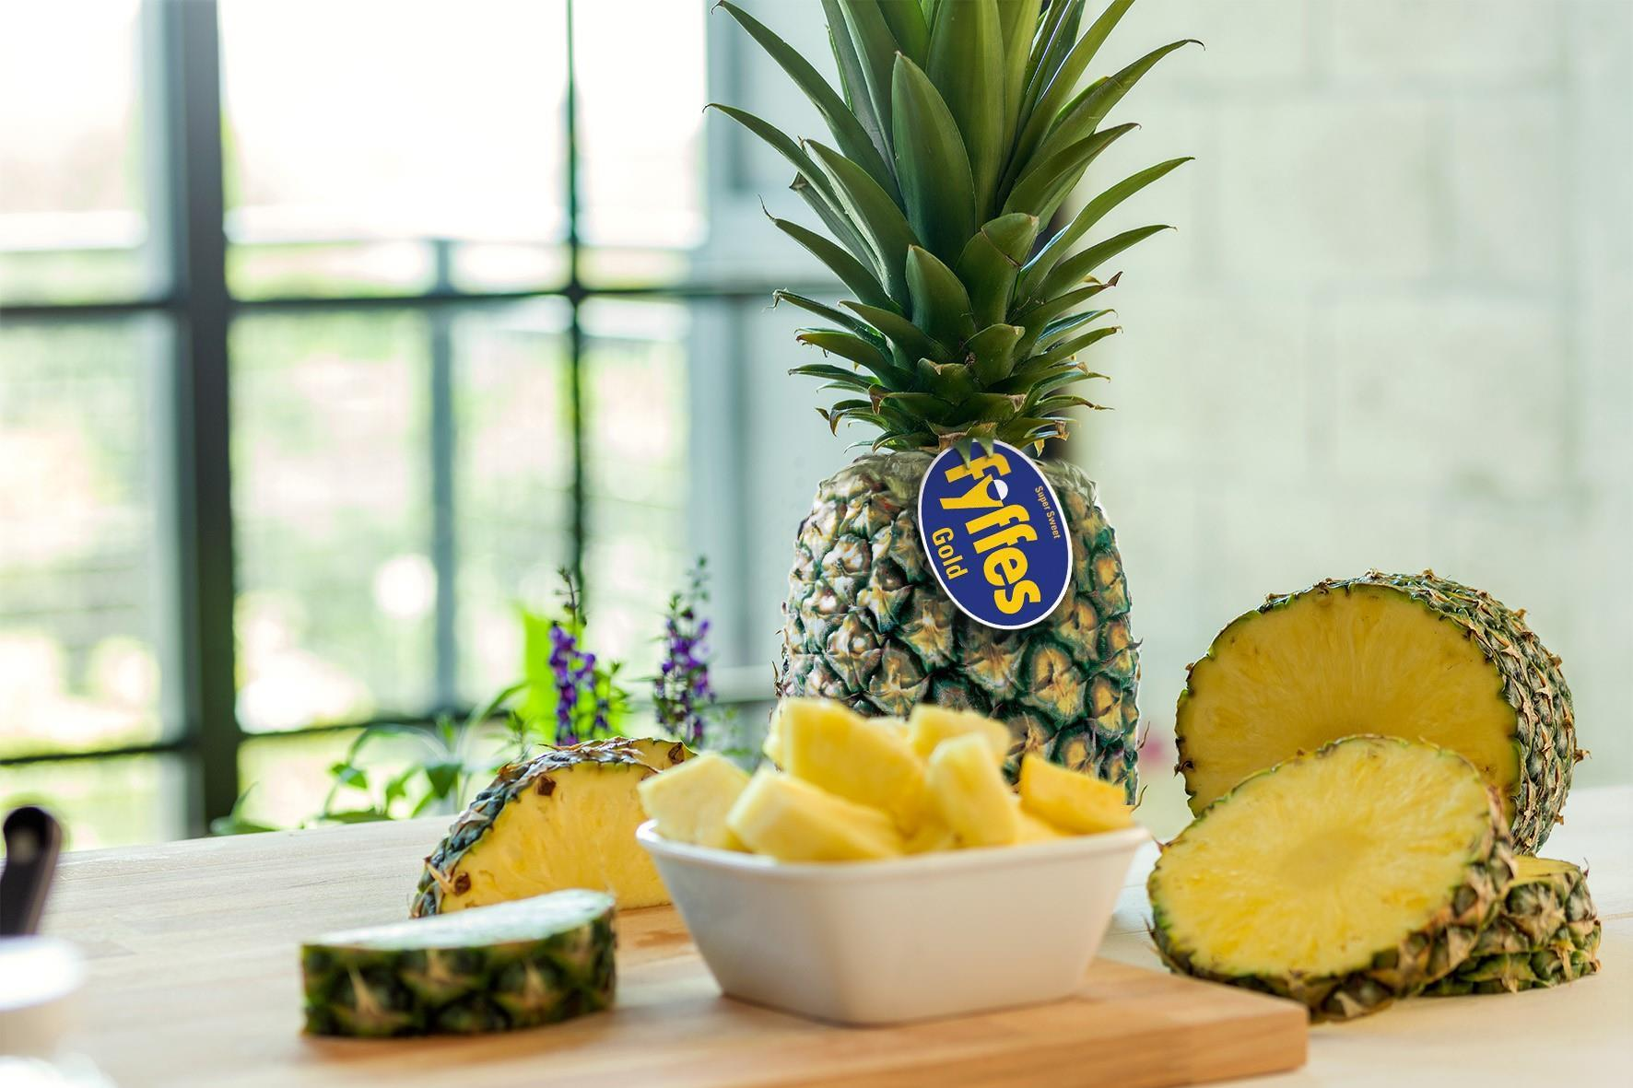

Data-Driven Solutions for Pineapple Disease and Pest Management
"Healthy Roots, Thriving Fruits – A Disease-Free Future for Fyffe Pineapples."
Group 10
Xiaoxue Ji, Anubhav Kumar, Utkarsh Shivam, Shaan Sheejo, Siling Ying, Lu Zhou, Yin Zhang

Slide 2
Objectives
1
2
3
About data:
Data Overview
Data Cleaning & Integration
Analysis & Insights:
Dashboard Snapshot
Pest Analysis & Climate Impact
Root Health Insights
Conclusions & Recommendations

Slide 3

Data Overview
The dataset consists of three primary components：
1
Weather Data – Includes historical records of temperature, rainfall, and radiation to analyze environmental influences on pest and disease trends.
2
Pest & Disease Records – Tracks occurrences over time to identify patterns and correlations with weather conditions.
3
Geographical Factors – Considers altitude, proximity to forests, and topography to assess risk levels for different production blocks.

Slide 4



Data Cleaning & Integration
A
Handling Missing & Duplicate Data
– Forward-filled gaps in pest & climate data, removed duplicates.
Standardization & Optimization
– Checked and verified common keys ("Date", "Lot", "Block") to avoid inconsistencies in joins & aggregations.
B
Data Cleaning & Merging
– Dropped irrelevant fields that were not required for pest, climate, or mortality analysis to keep datasets efficient.
C

Slide 5
KPI Summary
1
2
3
Trend Analysis & Early Warning
Monitor pest and disease patterns to detect risks before outbreaks occur.
Risk Identification
Correlate weather and geographical factors with pest and disease data to pinpoint high-risk periods and locations.
Proactive Intervention
Enable timely decision-making and targeted actions to mitigate potential threats.

Slide 6
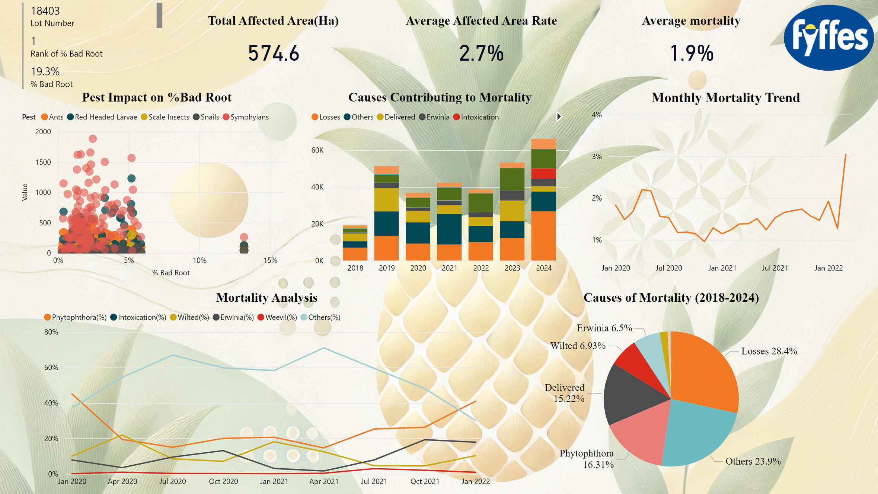

Slide 7
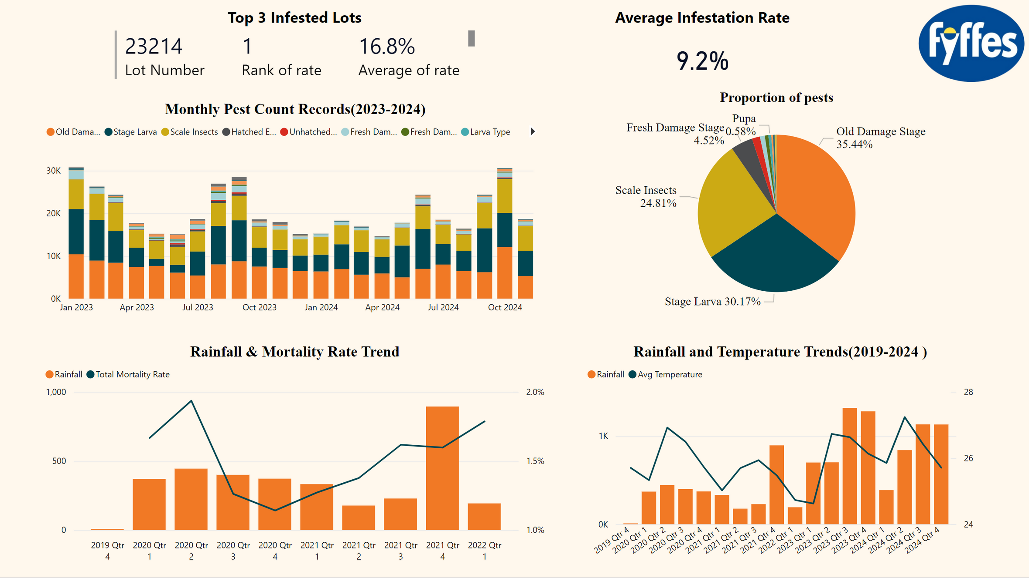

Slide 8


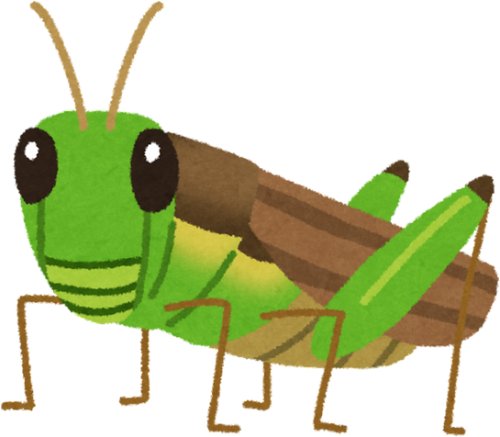
Analysis
Pest Analysis
Climate Impact

Slide 9
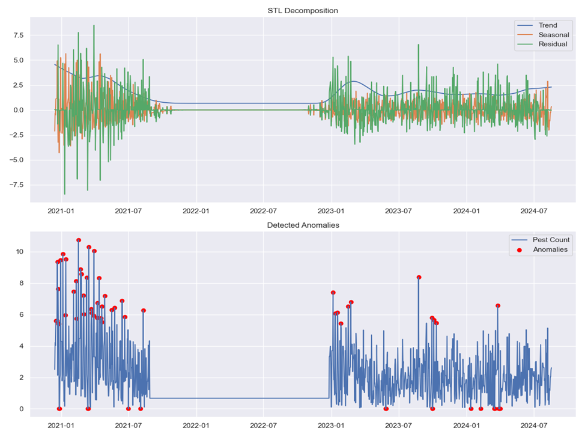
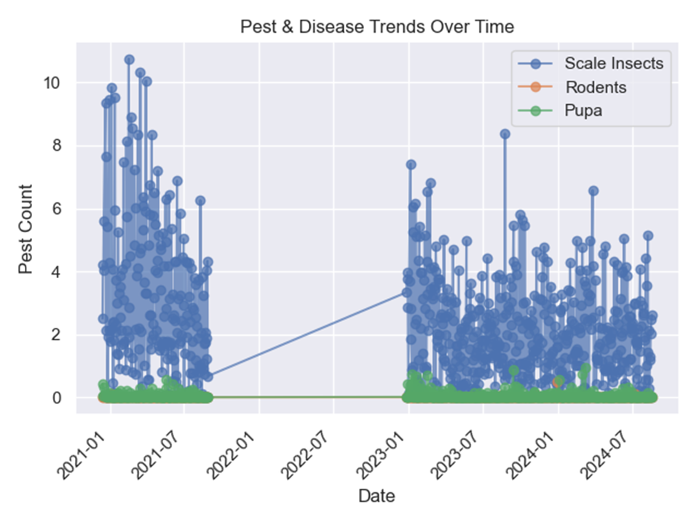
Analysis
Pest Cycles & Climate Impact
Dominant Pests & Data Gaps
Pest outbreaks follow seasonal patterns and climate events, with significant spikes in 2021 and 2023, while a drop in 2022 requires further investigation.
Scale Insects show frequent spikes, while Rodents and Pupa remain low; missing data and anomalies emphasize the need for improved pest prediction models.

Slide 10
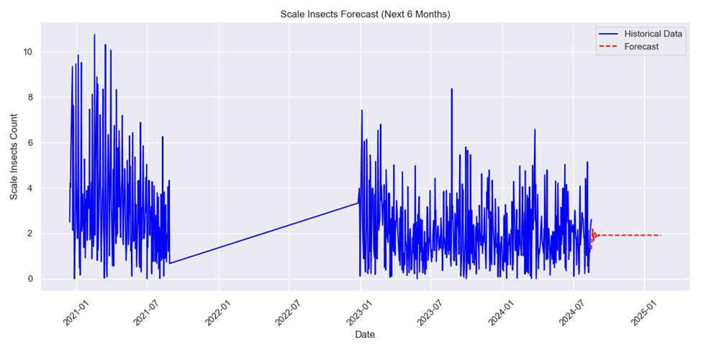
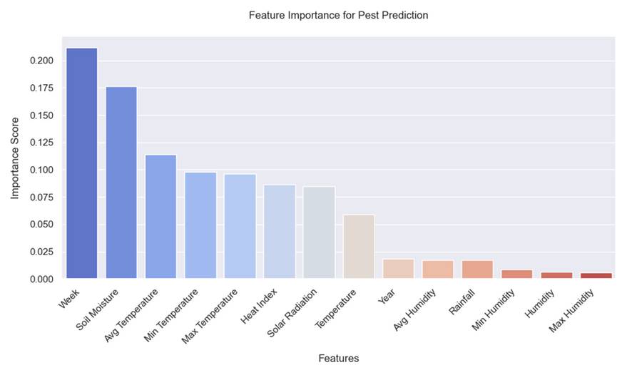
Analysis
The analysis shows stable, low-scale insect infestations in the next 6 months, with historical data highlighting early high pest activity that gradually stabilizes over time.
Pest activity is primarily influenced by the week of the year, with soil moisture, temperature, and heat index having a significant impact, while humidity and rainfall play a lesser role.

Slide 11

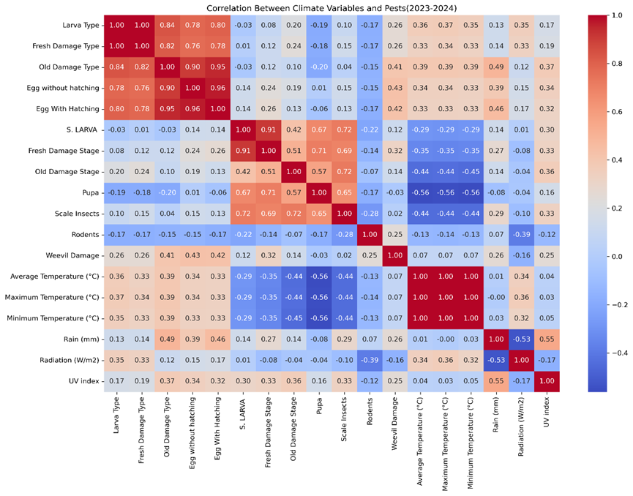
Correlation Table
Pest Development Correlation – Strong internal correlation (0.7-0.9) within the same pest species; early-stage growth leads to potential outbreaks.
Temperature Impact – Warmer conditions promote larval development but may hinder pupation and scale insect survival.
Rainfall Influence – Higher humidity supports egg hatching, with varying effects on different pest types.

Slide 12
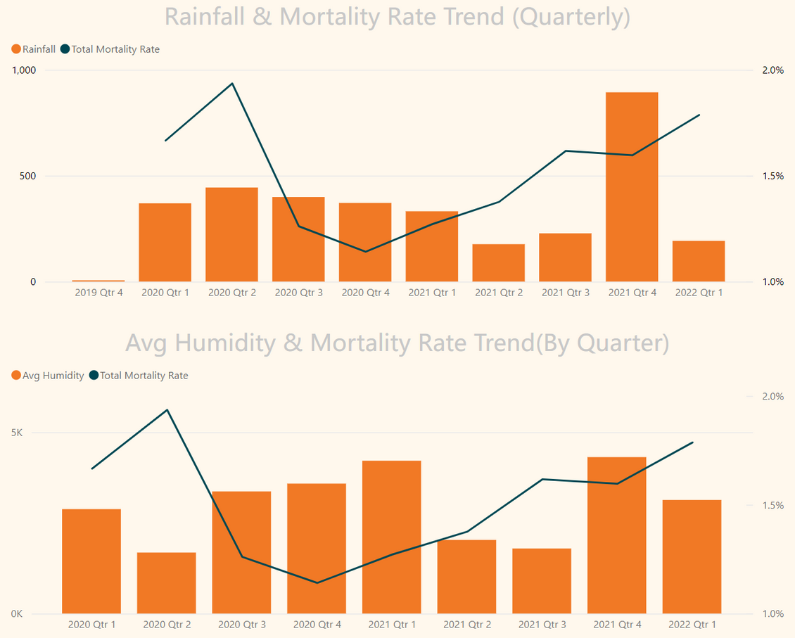
Rainfall & Mortality
Extreme rainfall (Q2 2020, Q4 2021) coincides with high mortality rates, indicating that extreme rainfall could enhance disease spread or crop stress.
Humidity & Mortality
Low humidity (Q2 2020) also contributed to high mortality, likely causing water stress and crop weakening.
As humidity increased (Q4 2021), mortality rate also rose, likely due to high moisture

Slide 13
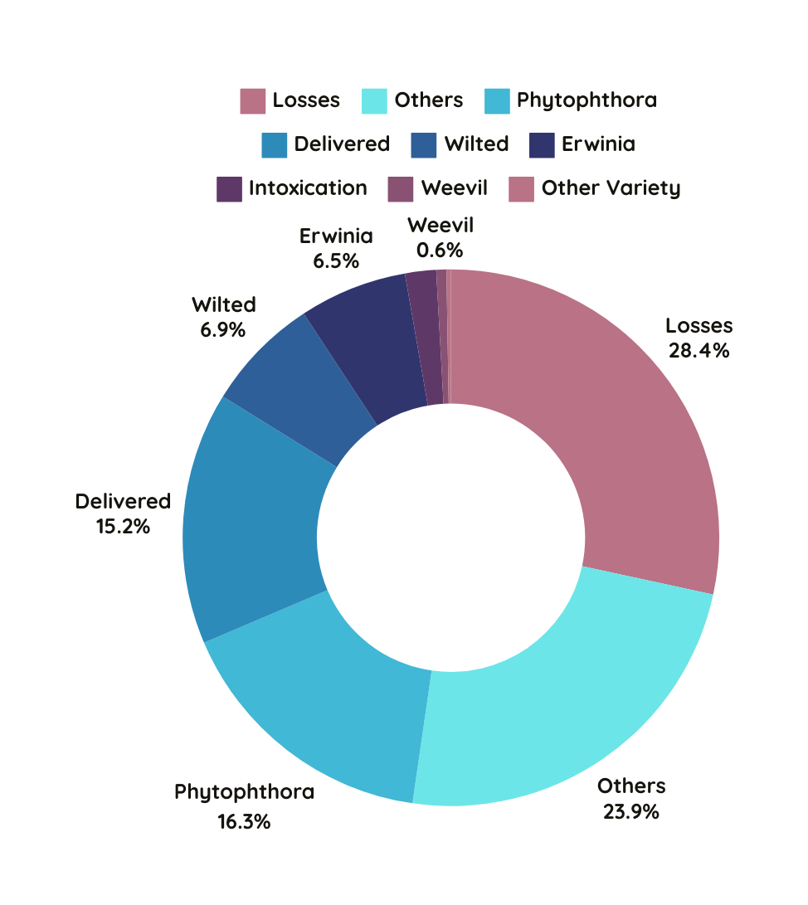
Causes of Mortality (2018-2024)
Most of deaths fall under Losses(28.4%), requiring further study—potentially linked to weather, soil, etc.
23.9% of the disease causes fall under Others, suggesting a need for further categorization and detailed analysis.
Phytophthora (16.3%) signals a clear priority for resource allocation and targeted prevention.
Delivered (15.2%) could be related to uneven fertilization across different plots.

Slide 14
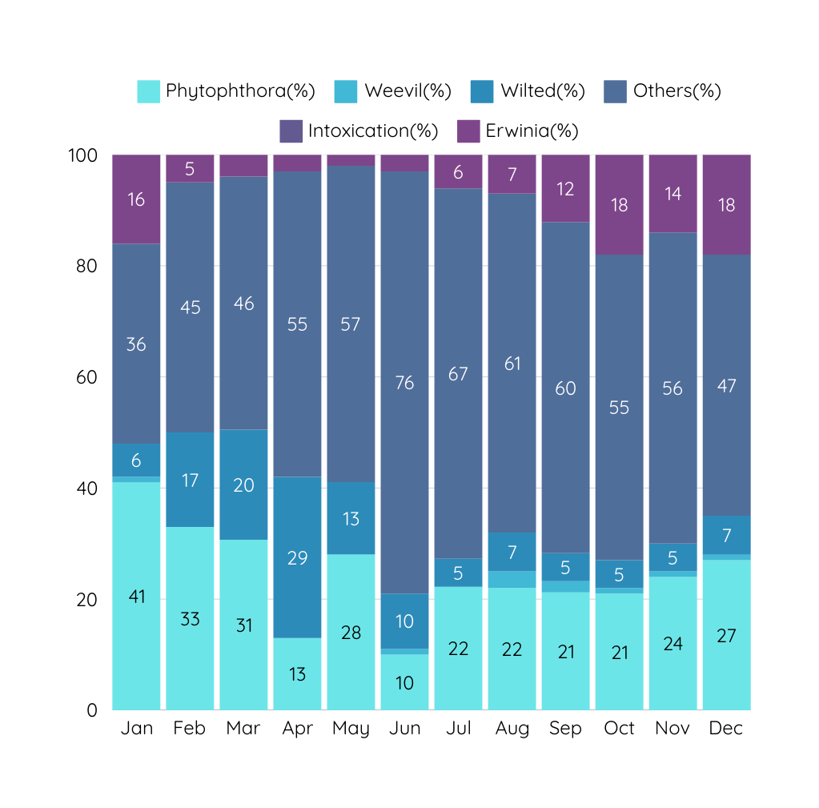
Disease Distribution by month
Throughout the year, "Others" represents the largest share
Phytophthora remains present year-round but is highest in January–March
Wilted peaks from February to May then declines
Erwinia increases between September and December
Weevil and Intoxication have minimal impact

Slide 15
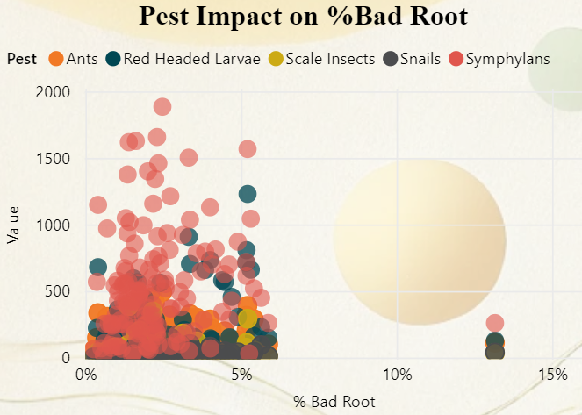
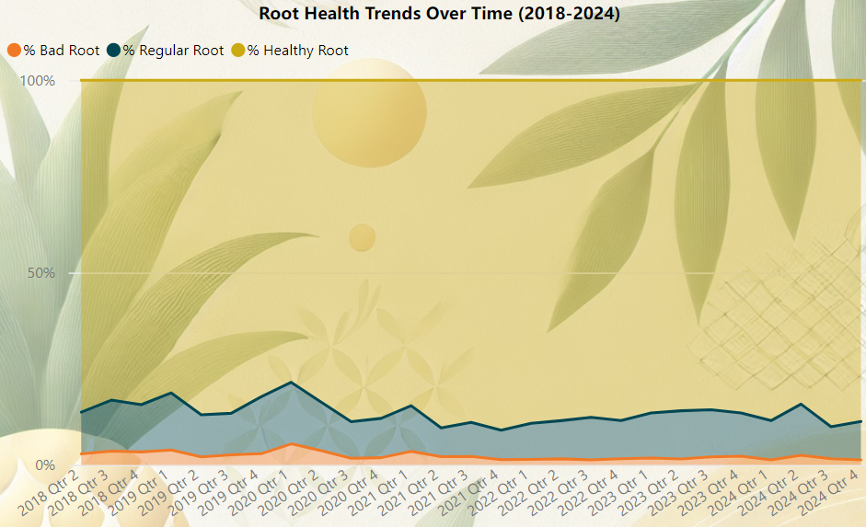
Root Health Insights
Dominant Pests & Bad Root
Root Health Overview
Symphylans (red) are the most abundant but may have a limited impact on root damage.
Scale Insects and Snails are linked to a higher % Bad Roots and should be prioritized for control.
Healthy Roots consistently comprise the majority (~80-90%), indicating stable root health management.
Bad Roots remain below 5%, but periodic increases suggest areas for improvement.

Slide 16




Key Findings Summary
1
2
3
Rising Mortality Rates related to pest outbreaks
Rising Mortality Rates related to environmental factors
Root Health & Bad Root Spikes
Phytophthora (16.3%) and "Other" diseases (23.9%) are key contributors to plant losses.
28.4% of losses remain unclassified under the category "Others," indicating a need for better disease identification and targeted control strategies.
Extreme rainfall events (Q2 2020 & Q4 2021) have led to increased mortality rates
Low humidity periods (Q2 2020) were also linked to high mortality
Temperature is the most significant factor influencing pest outbreaks, according to the correlation analysis.
Bad roots remain below 5% but show periodic spikes, indicating that root stress is an occasional but manageable concern.
Symphylans are abundant but do not strongly correlate with bad roots, meaning they should not be a primary focus for pest control.

Slide 17
Recommendation
1
Targeted Disease & Pest Management Strategies
Prioritize Phytophthora prevention (16.3%): regular application of fungicides during peak disease periods (Jan–March).
Further analyze "Other" diseases (23.9%): Implement advanced disease tracking to classify unidentified diseases; Strengthen soil microbiome analysis to determine underlying causes.
2
Climate-Responsive Pest & Disease Control
Mitigating Extreme Rainfall & Humidity Fluctuations: Implement better irrigation and drainage solutions for flood-prone areas; Introduce mulching & moisture-retention soil techniques to mitigate drought effects.

Slide 18

Optimized Resource Allocation for High-Risk Areas/Disease
3
Focus Control Efforts on Highly Infested Lots (16.8%): The Top 3 most infested lots should receive priority intervention.
Balanced nutrient application could reduce “Delivered” losses (15.2%).
Unknown disease category “Others” (23.9%) remains the second largest contributor to losses → More research is required before allocating treatment budgets
Yield Protection & Supply Chain Stability
4
Diversify sourcing strategies in lower-risk locations to balance yield variations caused by climate and pest fluctuations.
Enhance predictive yield modeling using pest and climate trend analysis, Align supply chain contracts and contingency plans based on these predictions.

Slide 19





Thank You
For Watching

